Slide 1

Welcome
Notes:
Topic: Know Your Why
Time: 30 minutes
Purpose of training evolution: Sailors will discuss warrior ethos components to gain an understanding of their why.
Expected outcome of training evolution: Sailors will be able to employ their why as a Warrior Toughness tool.
Safety: Inform Sailors of safety hazards in the training environment. For some topics, Sailors should be informed if there is a designated person to talk to if the Sailor feels compelled to leave the training.
Facilitator Actions:
Display slide.
Greet Sailors.
Introduce yourself and give any background on yourself that might be of interest.
Establish credibility.
Facilitator Instructions:
The slide deck acts as a guide to present a facilitated discussion that may include activities.
Best practice: Use the slide to develop interest in the subject matter. Do not read the slides word for word. The Sailors should be able read the text and understand the messaging presented in the graphics.
Facilitator notes are available for each slide to help the Facilitator deliver the topic.
Best practice: Use the Slide Show view to ensure the Facilitator notes are viewable.
The Facilitator notes are divided into general instructions for Facilitator Actions (mechanics of facilitation) and the Facilitator Content (Inform, Discuss, Perform, and Reference).
Best practice for Inform: Present facts, concepts, and procedures. Depending on the facilitator’s expertise, content may be used as background information or suggested talking points. Content in quotation marks is recommended to be read verbatim.
Best practice for Discuss: Conduct large-group question and answer sessions or large-group, Facilitator-led activities. Depending on the subject matter, these may be written as questions with expected answers or scripted activities.
Best practice for Perform: Facilitate small-group, scenario-based or procedural activities. Depending on the subject matter, these may be written with specific actions the Sailors will take or general ways for the Facilitator to monitor the activities. The Facilitator will be provided with expected outcomes to ensure Sailors leave training with correct information.
Best practice for Reference: This is for Facilitator use only.

Slide 2
Introduction
Warrior Toughness
MIND • BODY • SPIRIT
Warrior Ethos: Know Your Why
Notes:
Facilitator Actions:
Display slide.
Introduce topic.
Let Sailors know that they can leave the discussion if they have to for their own well-being.
Ensure that misinformation is corrected immediately.
Monitor the discussions of the Sailors throughout the training event.
Facilitator Content:
To build Warrior Toughness, Sailors will explore Warrior Toughness and the Warrior Mindset and participate in discussions to enable Sailors to develop their why (warrior ethos).

Slide 3
Learning Objective
Commit to a greater purpose by employing character, conviction, and decisiveness by knowing your why.
Notes:
Facilitator Actions:
Display slide.
Neither Sailors nor Facilitator should read the objective out loud.
Facilitator Content: N/A

Slide 4
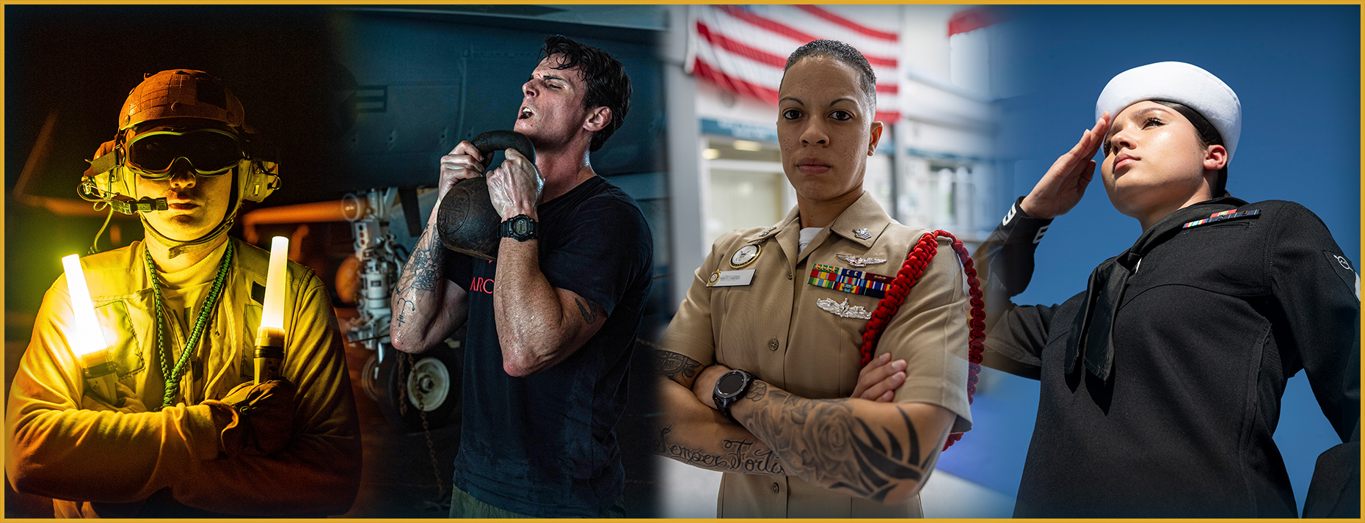
Toughness
What does toughness mean to you?
Notes:
Facilitator Actions:
Display slide.
Discuss how graphic relates to topic.
Monitor the discussions of the Sailors.
Facilitator Content:
Inform:
Toughness definition: “We can take a hit and keep going, tapping all sources of strength and resilience. Through rigorous training for operations and combat, the fighting Spirit of our people, and the steadfast support of our families, we maintain a culture of warfighting excellence and hone our warfighting ethos. We don’t give up the ship, we never give up on our shipmates, and we never give up on ourselves. We are never out of the fight.”
Discuss:
Ask the Sailors, “What does toughness mean to you?”
Reference:
U.S. Navy. A Design for Maintaining Maritime Superiority, Version 2.0. Washington, D.C.: Department of the Navy, December 2018.

Slide 5
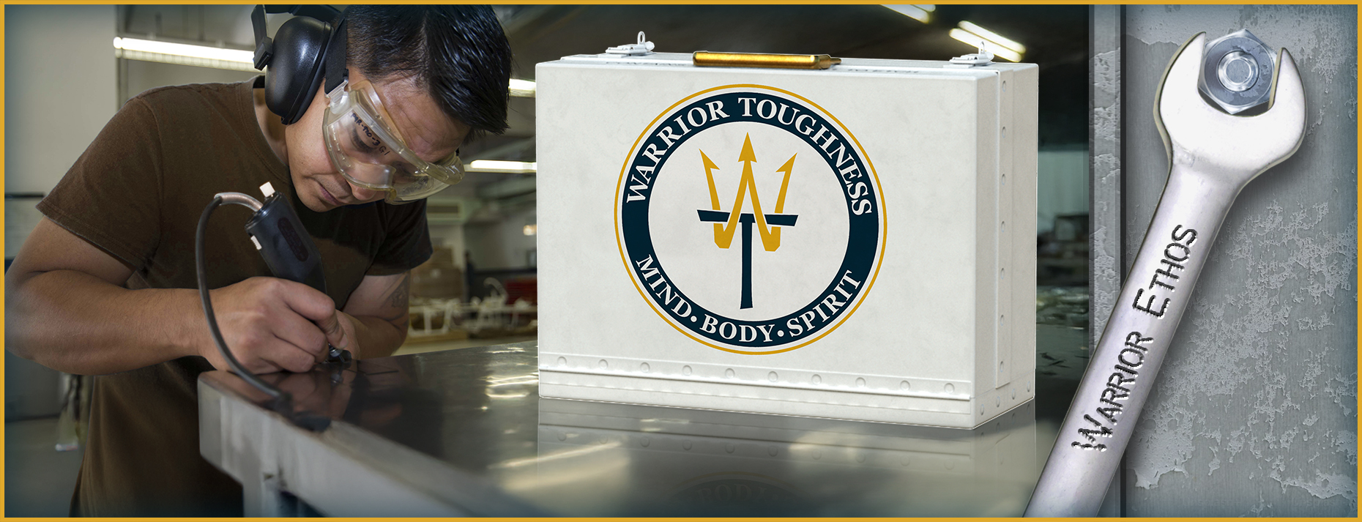
Warrior Toughness
Notes:
Facilitator Actions:
Display slide.
Discuss how graphic relates to topic.
Monitor the discussions of the Sailors.
Facilitator Content:
Inform:
Warrior Toughness definition: “Warrior Toughness is a toolbox designed to help every Sailor in the Navy team take a hit and keep fighting, to optimize their performance, to perform under pressure, and to recover and excel whether in combat or in life.”
Warrior Toughness is the Navy’s groundbreaking program designed to maximize Sailor performance and mitigate stress by developing toughness and resilience.
Reference:
U.S. Navy. Warrior Toughness Placemat. Washington, D.C.: MyNavy HR, n.d.

Slide 6
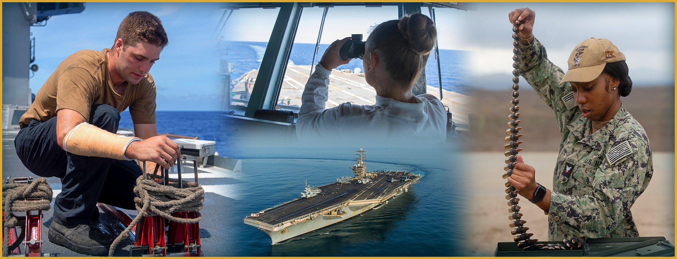
Warrior Toughness: Attributes
Notes:
Facilitator Actions:
Display slide.
Discuss how graphic relates to topic.
Monitor the discussions of the Sailors.
Facilitator Content:
Inform:
Warrior attributes include qualities such as these:
Take a hit and keep fighting.
Perform under pressure both mentally and physically for any duration.
Stay focused and ready when your job-specific tasks become boring and mundane.
Having entered the Great Power Competition, we are increasingly likely to perform naval combat engagements unlike any that have been undertaken since World War II. Now more than ever, we require our Sailors to be mentally, physically, and spiritually tough.
To learn more about Warrior Toughness, go to mynavyhr.navy.mil.

Slide 7
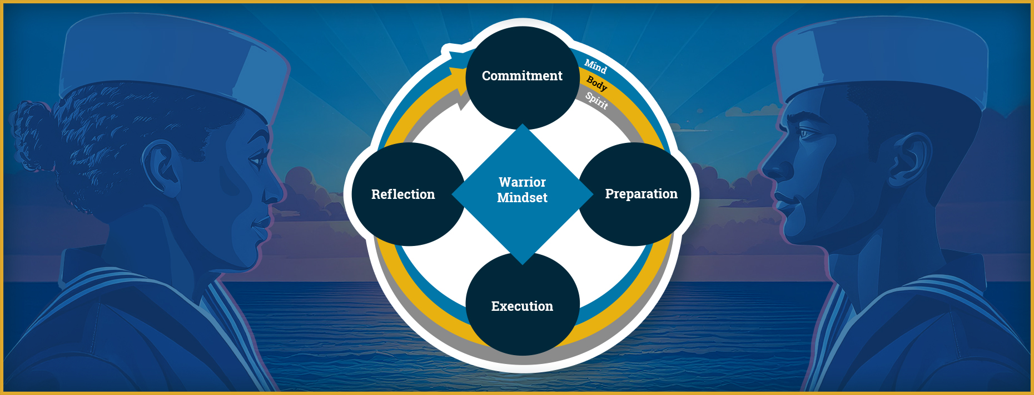
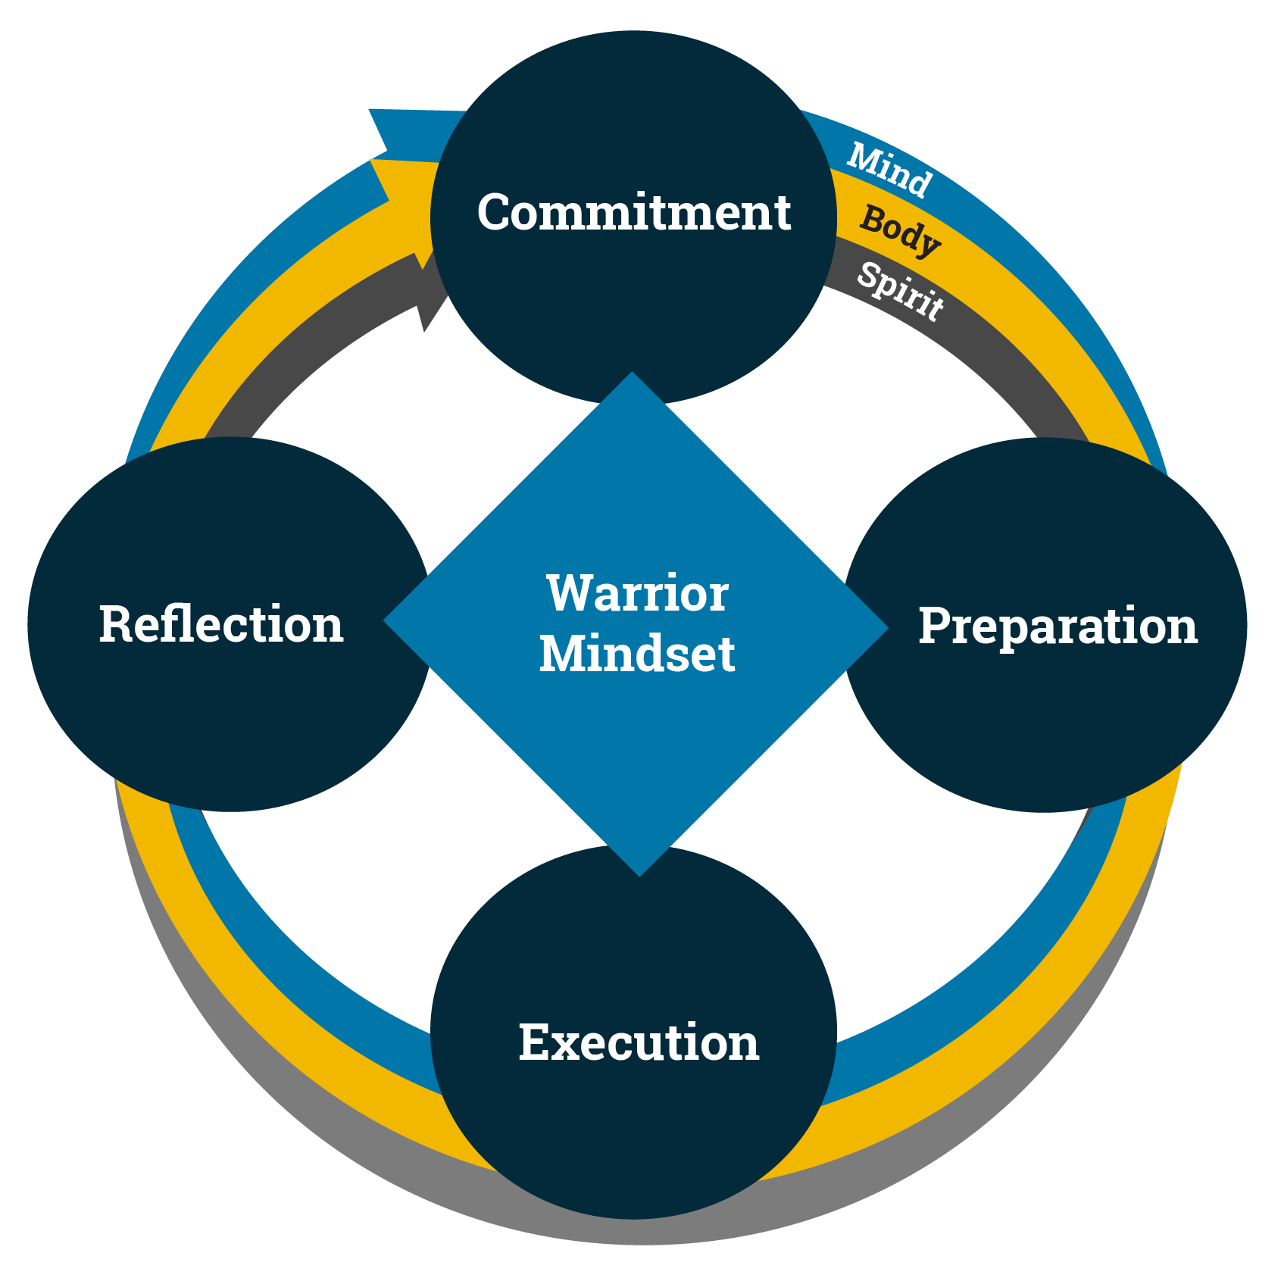
Warrior Mindset: Cycle of Excellence
What does Warrior Mindset mean to you?
Notes:
Facilitator Actions:
Display slide.
Discuss how graphic relates to topic.
Monitor the discussions of the Sailors.
Facilitator Content:
Inform:
The goal of Warrior Toughness is to enable the Warrior Mindset:
Knowing what we are committed to
Preparing for the event or mission
Executing at peak performance
Reflecting on what went right and areas of opportunity
The Warrior Mindset can only be effective if each domain includes the building and maintenance of our Mind, Body, and Spirit.
Discuss:
Ask Sailors, “What does Warrior Mindset mean to you?”
Expected answers may include:
Recognizing my purpose
Committing to protect and defend my values
Placing the needs of others ahead of my own
Going into the fight with an aim to endure hardship and accomplish the mission
Courageously protecting others and living my life of sacrifice and service for objectives greater than myself
Accomplishing all duties with honor
Discuss:
Ask Sailors, “Why is it important to integrate the Warrior Mindset into your professional and personal life?”

Slide 8
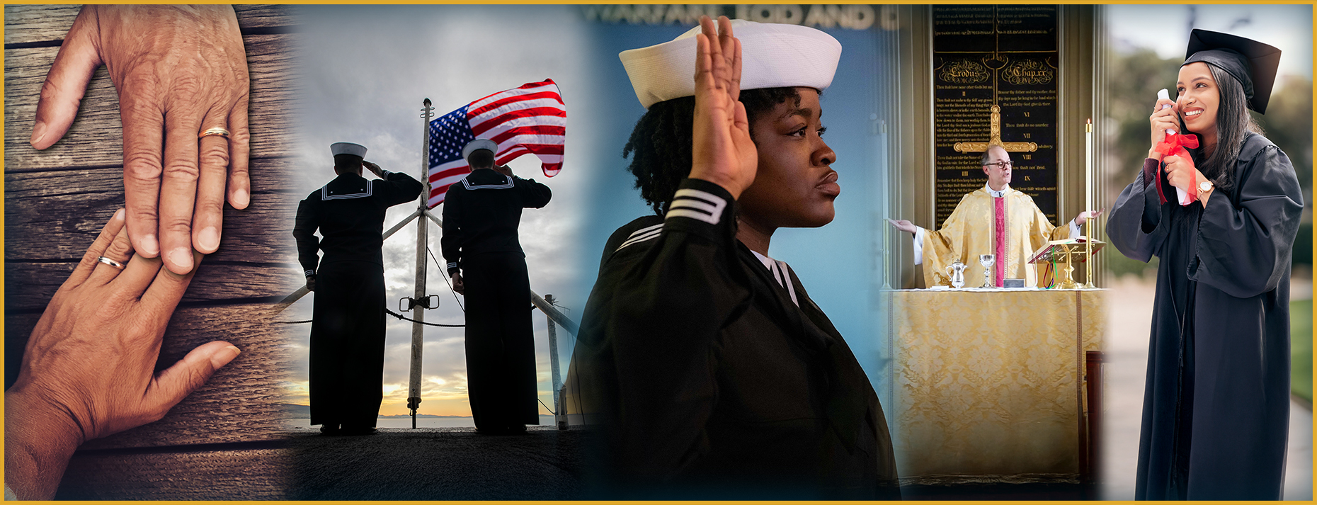
Warrior Mindset: Commitment
What is a commitment that is important to you?
Notes:
Facilitator Actions:
Display slide.
Discuss how graphic relates to topic.
Monitor the discussions of the Sailors.
Facilitator Content:
Inform:
The Warrior Mindset begins with the commitment phase. Our commitment is based on our character and values; it is where our personal and professional goals reside and what propels us in the Warrior Mindset.
Discuss:
Ask Sailors, “What is a commitment that is important to you?”

Slide 9
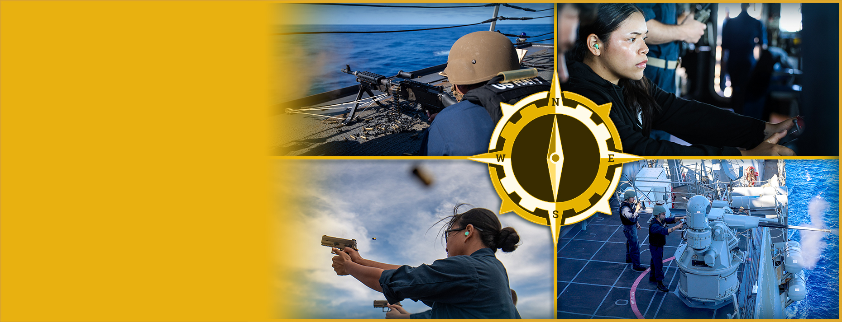
Warrior Ethos: Know Your Why
Guiding values that fuel the fighting Spirit (conviction) and serve as a compass (decisiveness) to reach a desired destination
Notes:
Facilitator Actions:
Display slide.
Discuss how graphics relate to topic.
Monitor the discussions of the Sailors.
Facilitator Content:
Inform:
Warrior ethos definition: “A written statement of a Sailor’s commitment and sense of purpose”
It is a letter from you to your future self, reminding you of the fundamental beliefs and values you hold, and what you fight for on a personal and organizational level.
These beliefs and values, especially during times of intense stress, help us maintain hope, optimism, and perspective.
If you have never prepared a warrior ethos statement, take the time to do so. If you haven’t revisited your warrior ethos since recruit training, take the time to review and update it.
Make it a habit to revisit your warrior ethos statement at major milestones in your life such as when you earn a promotion, or when you report to a new command.
Discuss your warrior ethos with your supervisor as part of your onboarding or during mid-term counseling.
Reference:
U.S. Navy. Warrior Toughness Playbook. Washington, D.C.: MyNavy HR, n.d.

Slide 10
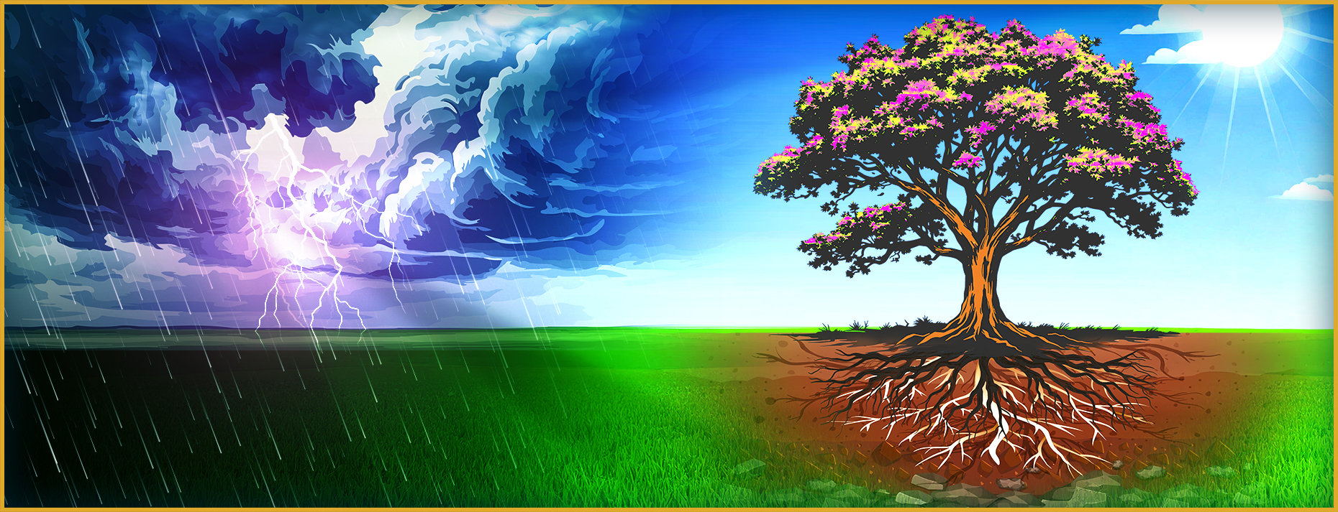
Know Your Why: Spirit
What moves us when the fuel tank is empty?
Notes:
Facilitator Actions:
Display slide.
Discuss how graphic relates to topic.
Monitor the discussions of the Sailors.
Facilitator Content:
Inform:
Developing strong character builds the mental toughness needed to face challenges in both work and life. A personal warrior ethos empowers resilience and unwavering determination, even when confronted with overwhelming obstacles.
By the word character, we mean who we are and why we do what we do. When we reference Spirit in the context of Warrior Toughness, it is neither a religious nor anti-religious term. We are referring to the Spirit as our strength of character. Strengthening one's character comes through practicing one's personal faith, for some.
Through regular practice, we can develop our Spirit by working toward the person we want to become. For example, we can review our daily actions and ask ourselves:
Did I behave in a way that aligns with the character I am working toward?
Did my behavior reflect good leadership qualities?
Spiritual development enhances our ability to perform with greater decisiveness and conviction.
Decisiveness is the ability to make decisions quickly and confidently. When we have a firm grasp on our values and beliefs, circumstances do not dictate our decision-making. Our values and beliefs guide us to take the lead and act decisively.
Conviction is believing in ourselves, our values, and our decisions. When we take the time to know ourselves and what values and beliefs guide us, we can act thoughtfully and confidently.
As Sailors, it is only a matter of time before we will find ourselves in a situation that will expose our Spirit.
Discuss:
What moves us when the fuel tank is empty?

Slide 11

What Has Made You Who You Are?
What is one life experience or relationship that has impacted who you are today?
Notes:
Facilitator Actions:
Display slide.
Discuss how graphic relates to topic.
Monitor the discussions of the Sailors.
Facilitator Content:
Perform:
Instruct each Sailor to partner with another Sailor to discuss, “What is one life experience or relationship that has impacted who you are today?”
Allow 3 minutes for this discussion.
At the end of the 3 minutes, ask Sailors to come back together as a group and ask if any Sailors would like to share their responses.
Allow 2 minutes for Sailor responses.
Inform:
Many of your answers included experiences that impacted your Spirit. You may have experienced a situation or relationship that led to your belief that you never want to behave in a similar manner, or have thought to yourself, “This is what right looks like.” With these experiences, at least one of your values surfaced in your Spirit, and you realized something about your character and your values.

Slide 12
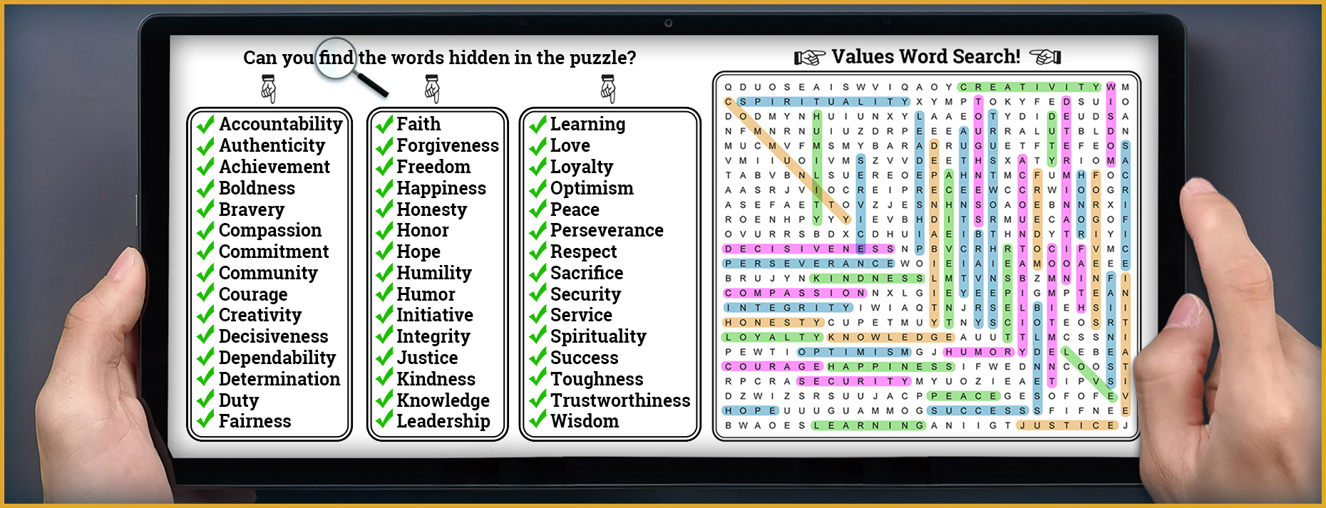
What Is Worth Fighting for and Why?
What principles or causes would you fight or sacrifice for, and what makes them worth it?
Notes:
Facilitator Actions:
Display slide.
Discuss how graphic relates to topic.
Monitor the discussions of the Sailors.
Facilitator Content:
Discuss:
Lead a 3-minute group discussion: What principles or causes would you fight or sacrifice for, and what makes them worth it?
Inform:
Regarding what we would be willing to fight for, notice the similarities in our answers. When we compare our answers for why we would be willing to fight, our answers vary. When we think of why we would be willing to fight, we are touching on the values that are unique to each of us.

Slide 13
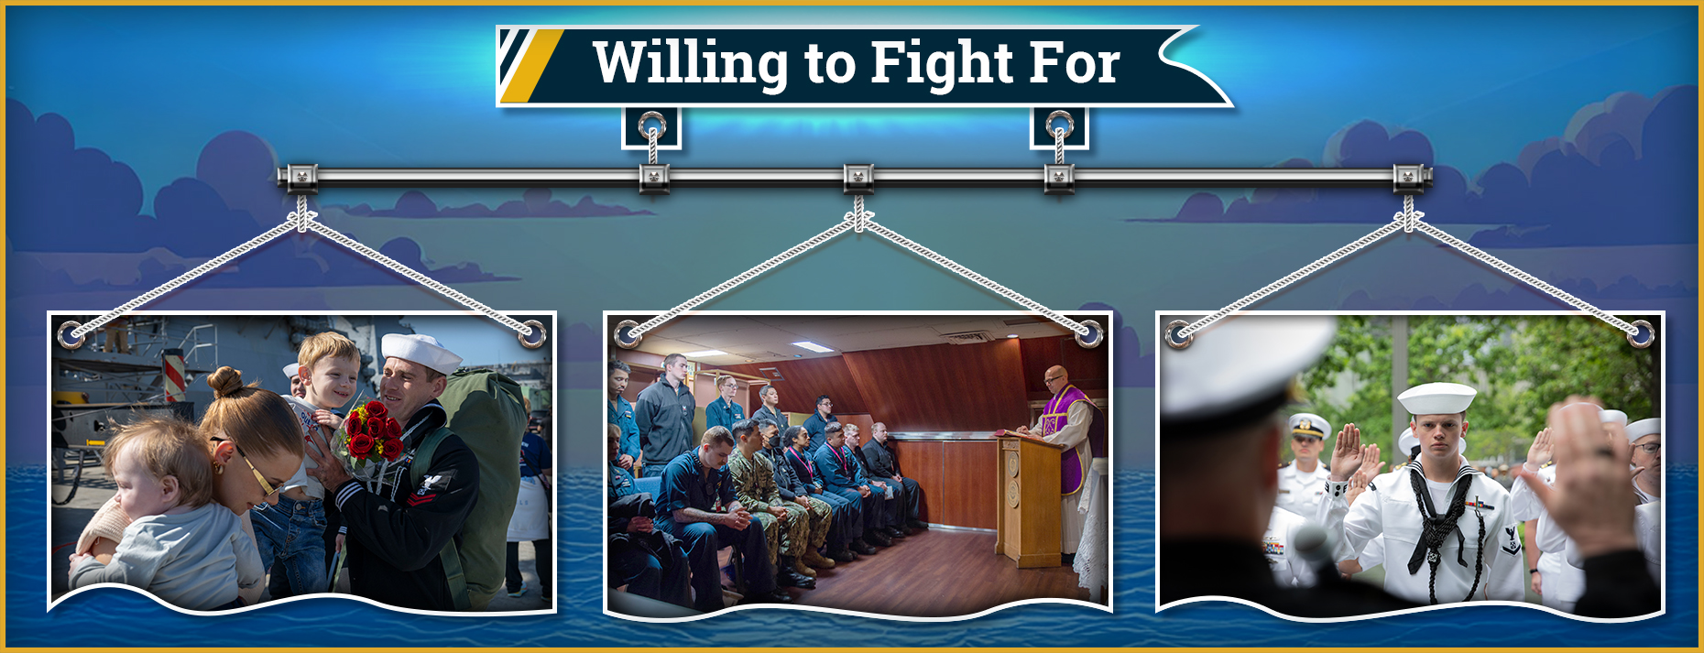
Spiritual Connections
How does your perception of who you are and what you are willing to fight for connect to self, the greater good, or a higher power?
Notes:
Facilitator Actions:
Display slide.
Discuss how graphic relates to topic.
Monitor the discussions of the Sailors.
Facilitator Content:
Inform:
The following are examples of what we are willing to fight for based on any of these three connections:
Self
Greater good
Higher power
When we know what we want and where we are heading, we can make the connection to ourselves (e.g., better life, promotion, or increased fitness level).
To connect to the greater good, we are tying into something outside of ourselves that we are willing to serve through personal sacrifice (e.g., family members, shipmates, community, or nation).
Making the connection to a higher power means connecting to something greater than ourselves. This does not necessarily mean a religious figure, though we may make that connection. This is connecting to something outside of the human race that resonates with us and our values (e.g., love, divinity, nature, or universe).
Note that not all of us will make the connection to self, the greater good, or a higher power. However, where we do connect sheds some light on our identities.
Discuss:
How does your perception of who you are and what you are willing to fight for connect to self, the greater good, or a higher power?
Inform:
What are your ultimate goals or desires for your connections? Consider what you want others’ perceptions of you to be (self).
Discuss:
What legacy do you want to leave with others and the world (greater good)?
What do you aspire to accomplish in your connection with your higher power?
Why do you think it's important to defend the Constitution and not a person? Answer: Because the Constitution is the law that protects everyone's rights and freedoms.
The Constitution starts with “We the People” and says we should keep peace at home and defend our country. How does your job in the Navy help do that?

Slide 14
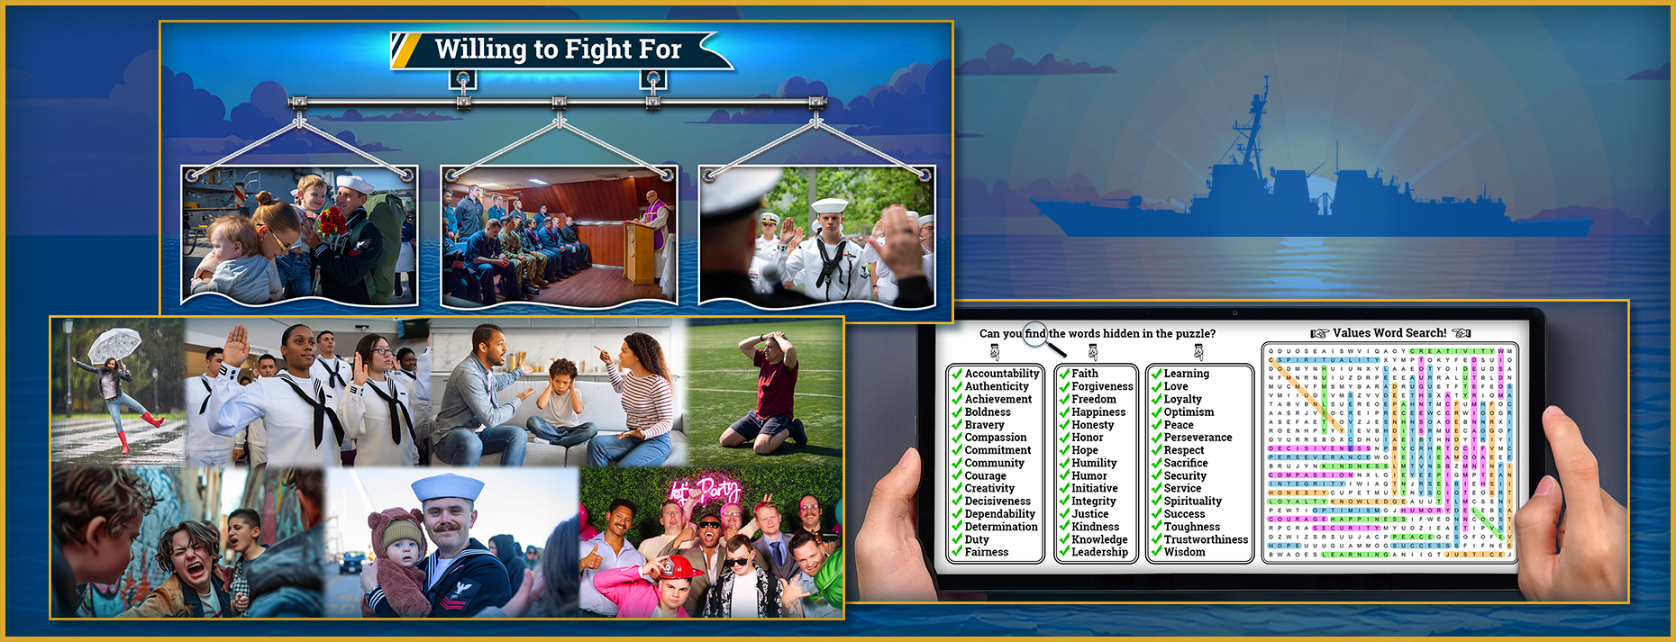
Know Your Why: I Am, I Will
What is an example of your why that connects to yourself, the greater good, or your higher power?
Notes:
Facilitator Actions:
Display slide.
Discuss how graphics relate to topic.
Monitor the discussions of the Sailors.
Facilitator Content:
Inform:
Knowing your why affirms your identity, connections, values, and goals. Your why may not be exactly as you view yourself currently. Counterproductive (negative) thoughts such as “I am not that person,” or “I will never achieve that goal,” may creep in. Recall that your why is who you aspire to be; it is your values in action and your personal code of conduct. Your why is a statement to you, from you, and about who you want to be, as well as the steps you will take to become the best version of yourself.
Self example: My life has value. I am always at the ready to fight for and defend freedom.
Greater good example: I am a loyal friend, colleague, and family member. I will honor the people I care about by ensuring my behavior reflects my character.
Higher power example: I serve my higher power by treating others with kindness, dignity, and respect even when I view them as unlikeable or unlovable.
Discuss:
What is an example of your why that connects to yourself? How might this change over time?
What is an example of your why that connects to the greater good? How might this change over time?
What is an example of your why that connects to your higher power? How might this change over time?
Inform:
As you move through the Warrior Mindset’s execution phase, your why should be sharpened, honed, and refined as you gain knowledge and experience. Keeping an updated record of your why allows it to guide your every step. Reviewing and refining your why will lead you to act with character, conviction, and decisiveness.

Slide 15
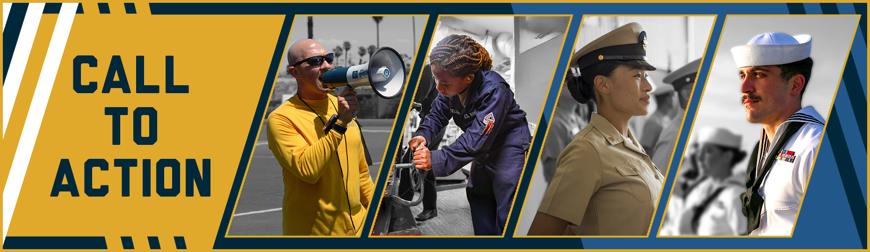
Call to Action
Continuously reference and update your why to work toward the Sailor you aspire to be!
Notes:
Facilitator Actions:
Display slide.
Review topics discussed and ask if there are any questions.
Check Sailor comprehension by providing review questions and/or problems.
Discuss how the call to action supports and encourages Sailors’ post training.
Relate call to action to Warrior Toughness.
Facilitator Content: N/A

Slide 16
References
Tools and Resources
U.S. Navy. A Design for Maintaining Maritime Superiority, Version 2.0. Washington, D.C.: Department of the Navy, December 2018.
U.S. Navy. Warrior Toughness Placemat. Washington, D.C.: MyNavy HR, n.d.
U.S. Navy. Warrior Toughness Playbook. Washington, D.C.: MyNavy HR, n.d.
Notes:
Facilitator Actions:
Display slide.
Facilitator Content:
Inform:
Identify tools.
Identify resources.

Slide 17
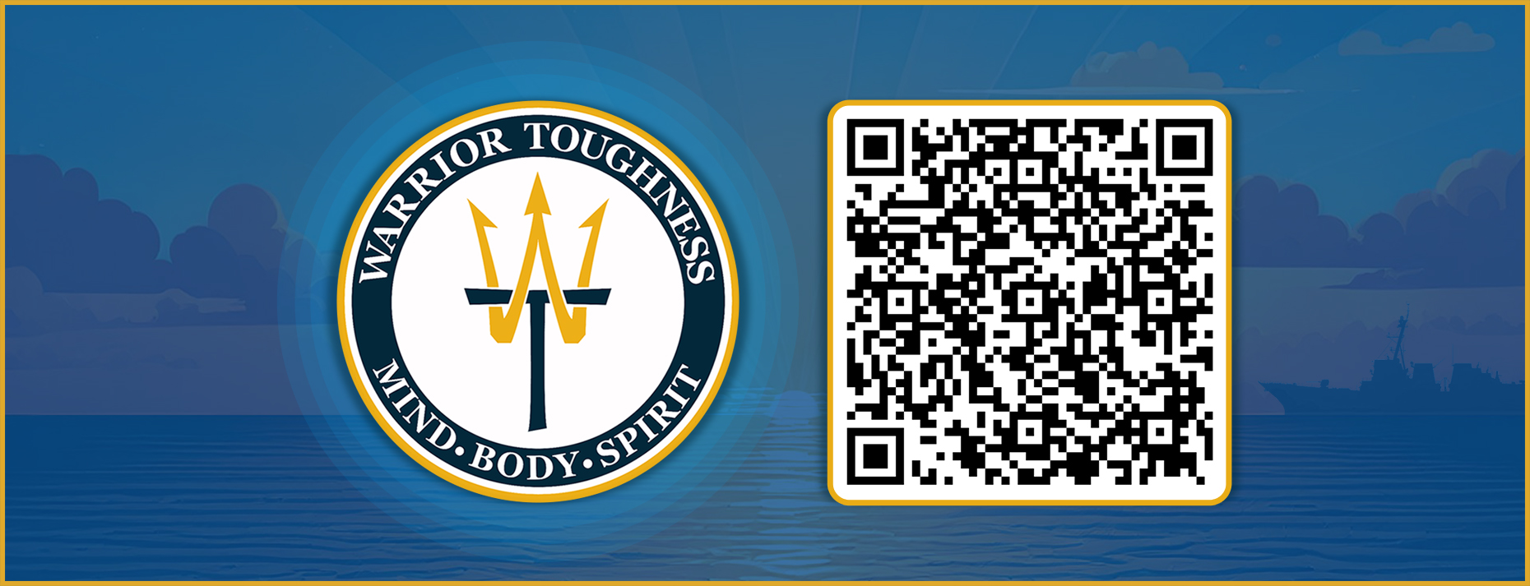
Warrior Toughness QR Code
Notes:
Facilitator Actions:
Display slide.
Facilitator Content:
Inform:
Identify Warrior Toughness QR code.

Slide 18
Glossary
Glossary
Acronym | Term
WT | Warrior Toughness
Notes:
Facilitator Actions:
Display slide.
Facilitator Content: N/A

